Slide 1
Bots + JS
Gavin Rehkemper
@gavinrehkemper @gavinr

Slide 2
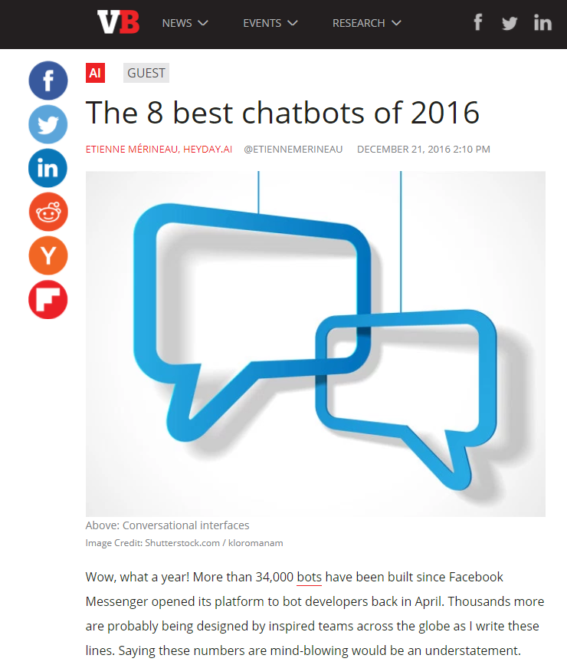

Slide 3
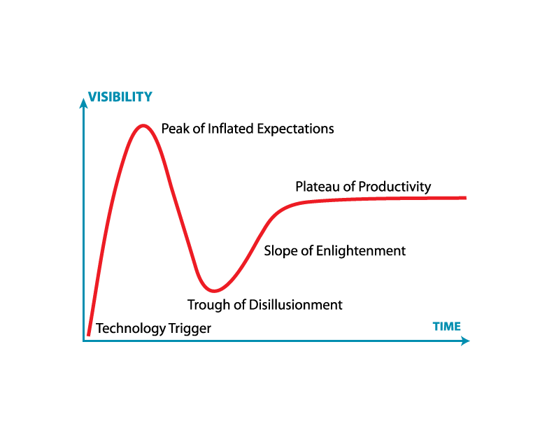
We tend to overestimate the effect of a technology in the short run and underestimate the effect in the long run.
https://en.wikipedia.org/wiki/Hype_cycle

Slide 4
https://chatbotsmagazine.com/80-chatbot-ideas-for-enterprise-bots-4bb73281f593

Slide 5

Excited?

Slide 6


Slide 7


Slide 8
Notes:
HelloWorld - https://vimeo.com/170647056:
Var botBuilder = require(‘claudia-bot-builder’);
Module.exports = botBuilder(function(message) {
// “message” is normalized across all platforms for you by botbuilder!
console.log(‘in message:’ message);
return `Hello, ${message.text}`;
});

Slide 9
Sources
https://www.claudiajs.com/
https://medium.freecodecamp.org/express-js-and-aws-lambda-a-serverless-love-story-7c77ba0eaa35

